Slide 1

How can we help youths to build resilience, at scale?

Slide 2


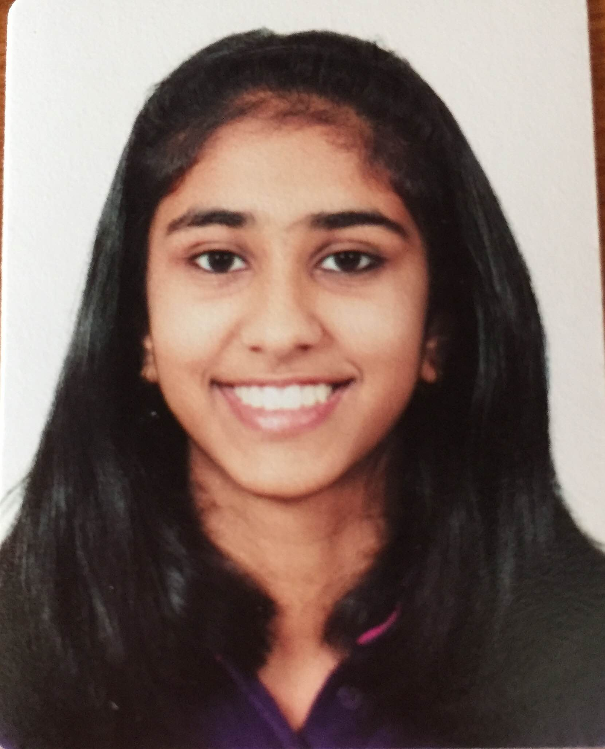
TEAM INTRODUCTION
Talagadadivi Durga Rukmini Manaswini
Year 3, Computer Engineering
National University of Singapore
Parvathi Ranjith Menon
Year 3, Computer Engineering
National University of Singapore
Shriya Saxena
Year 3, Computer Engineering
National University of Singapore

Slide 3
How can we help youths to build resilience, at scale?
Social anxiety is on the rise globally with 1 in 2 young people being affected by it
Between standardized testing and a culture of achievement, today's youth can feel pressure to succeed in ways previous generations did not
Today’s youth is constantly connected to social media. It's not surprising that their self-esteem―and worldview ―becomes connected to responses to social media posts and influencers.
Hiding from spotlight moments
Missed opportunity to show what they can do
Fear of judgment of not living up to societal expectations

Slide 4


Target Audience and Insights
Our purpose is to inspire youths from 16 to 25 years old to show the world what they are made of by helping them become resilient, clearing anxieties and self-doubt.
A study released by the Institute of Mental Health (IMH) in December last year found that young adults are most at risk of suffering from mental disorders in Singapore. Those aged between 18 and 34 are more likely to have experienced bipolar disorder, major depressive disorder, alcohol abuse, obsessive compulsive disorder and social anxiety
Several young Singaporeans simply do not know what to do when they find themselves or their friend emotionally distressed.

Slide 5
Target Audience and Insights (contd.)
The stressors among youth mainly revolve around family or intimate partner relationships, friendships, concerns about academic or work performance, financial worries and stress resulting from life transitions, said mental health professionals, and these have remained pretty much the same over the years.
The support structure, (from parents and friends) is important as young people require a lot of guidance. This doesn’t mean teaching them what to do, but to help them process and organize their feelings and thoughts.
Mental health advocates believe that there is also a need to teach young people, especially those who are still in school, how to build emotional resilience.

Slide 6
Proposed Details and Execution
Cognitive Behavior Therapy
Numerous research studies have found CBT to be the treatment of choice for social anxiety significantly more effective than medication or traditional talk-therapy [1]
Through learning and practice of CBT skills, people learn to become their own therapists, which is why CBT for social anxiety lasts significantly less time than traditional therapy.
Podcasts and Guided Meditation
Podcast listeners have grown by 37.5% in the past three years, and the podcast market has seen a big breakthrough with more people tuning in to listen to podcasts in their free time on topics such as comedy and personal development. This is seen to motivate them and put them at ease
Guided meditation and tuning into relaxing music is now on an upward trend as young adults are using such media to zone out and take a break from their hectic life
Gamifying CBT involves selecting suitable interventions, adapting them to a digital format while applying gamification principle
Both podcasts and guided meditation have had a positive impact on the mindset of young adults as reflected in the increasing numbers in their demand

Slide 7

With the prevalence of smart phones amongst the target audience and the growing fondness for games, podcasts and guided meditation – tranquilzen is a one-stop application that provides the youth with cognitive behavioral therapy through gamification and a collection of podcasts and guided meditation and exercise sessions to help control their nerves and eventually build resilience within them.
A lot of young adults struggle to reach out to mental health services. However, with digitalization and gamification of proven therapies, the rate for success is higher
With partnerships from certified psychologists and existing studies on gamification of CBT, this mobile application could be developed to fit into the needs of the young adults in aiding them build their interpersonal skills, problem-solving capabilities, and help them relax.
Moreover, guided meditation and relaxation sessions have a great success rate in building skills to manage and cope with stress
Podcasts today have become a great platform for the youth to tune into as they make their way to work or colleges and get inspired

Slide 8
SCALABILITY | LIMITATIONS AND CONSIDERATION
CBT is reasonably scalable as it involves limited therapist contact and is a low cost method for treating social anxiety | Restricted tailoring to people’s needs
Personalization of games and recommended meditations and podcast based on the person's state and schedule can be done easily through matching and deployment of ML algorithms | Challenges with managing comorbidity and acute crisis
Chat sections could be introduced for people to anonymously share their experiences and get professional advice or from users alike | Lack of non-verbal signals
Tranquilzen can be expand to users of all age groups and be modify based on age and needs | Missing important disease aspects
 | The person may avoid tackling the difficult yet important issue
 | Risk of therapy discontinuation

Slide 9
References
https://www.healthychildren.org/English/health-issues/conditions/emotional-problems/Pages/Anxiety-Disorders.aspx
http://cogbtherapy.com/cbt-for-social-anxiety-disorder#:~:text=Through%20CBT%20for%20social%20anxiety,when%20there%20is%20a%20deficit.
https://www.channelnewsasia.com/news/singapore/mental-health-youths-suicide-depression-listen-11994612
Christie, Grant I., et al. “Gamifying CBT to Deliver Emotional Health Treatment to Young People on Smartphones.” Internet Interventions, Elsevier, 18 Oct. 2019, www.sciencedirect.com/science/article/pii/S2214782919300302.

